Slide 1

Unveiling Literary Insights
HARNESSING THE POWER OF DATA FOR PREDICTIVE MODELING
OF BOOK RATINGS THROUGH LINEAR REGRESSION
By Abdulla Mashaly, Jeremy Magee, Akhil Karandikar, and, Lori Girton

Slide 2

Our Epic Odyssey
Our first thought was to create a prediction engine, one that takes input from the user and outputs recommended books. Soon we realized some of the issues with such an approach
One issue was that we could not measure accuracy of the predictions
We pivoted to predicting book ratings given the multitude of data our APIs were giving us.
From there we tried several models and tweaks before using a linear regression learning model.
In tandem with that we tried a random forest classification, and it worked! There was much rejoicing.
Then we finally began our optimization process.

Slide 3

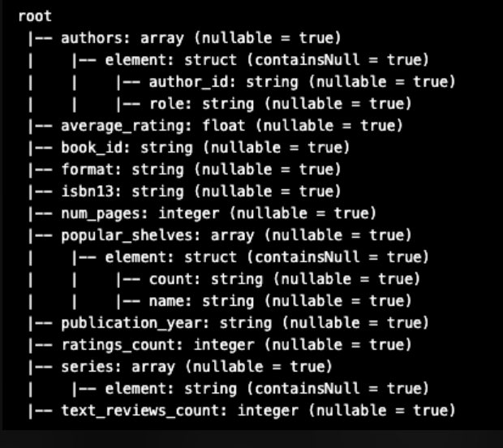
Let’s look at some Sample Data!
Our API was from Goodreads (via Kaggle), an open data source with multitudes of information about a given book.
This dataset includes everything about each book from ISBN, average author ratings, number of times a book appears on a to-read list, number of pages, etc.

Slide 4

Data Collection and Cleaning
PYSPARK AND SQL!

Slide 5


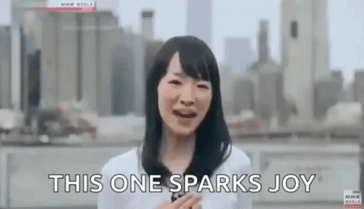
Our initial dataset had a size of 2 GB, which was unwieldy for the computing power and memory we have on hand.
PySpark was irreplaceable for caching our info into a manageable dataframe so that we could decide on necessary features for our model.

Slide 6

DATA CLEANING: WHAT THE HECK IS THAT?!
Data cleaning is necessary for the proper EDA needed to make a model
We cleaned the data and found many curious and odd entries:
Some examples:
Page Count
Published Year
Ratings
0
8,345
5 (yes, 5)
56204
0 (that’s just mean)

Slide 7
Data Exploration & Analysis

Slide 8

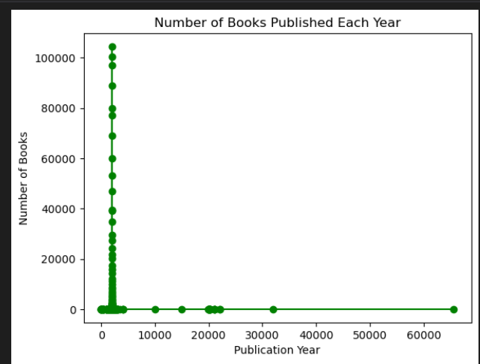
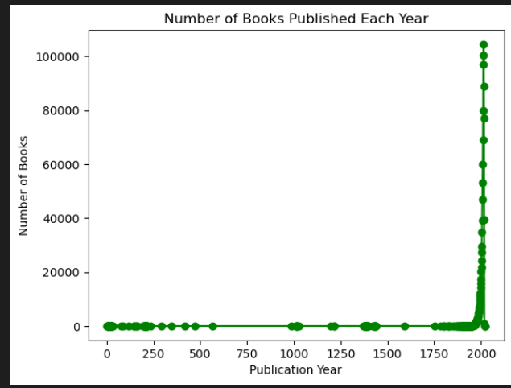
EDA
Step 1
:

Slide 9
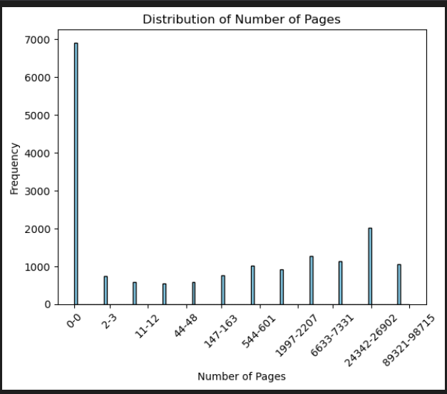
EDA Step 1

Slide 10
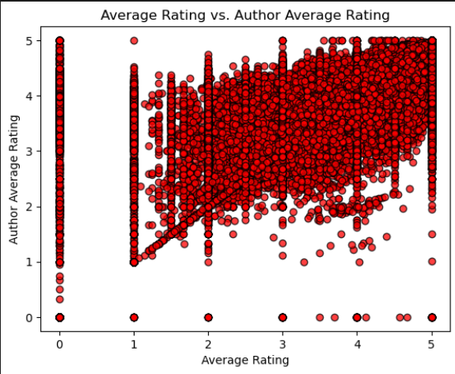
EDA Step 2

Slide 11
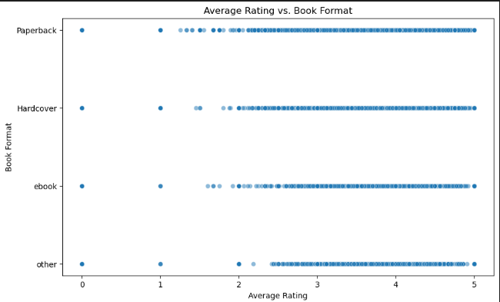
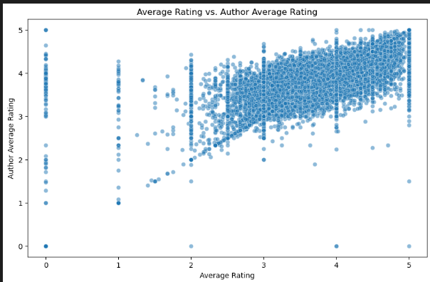
EDA: Sample 3 Data

Slide 12

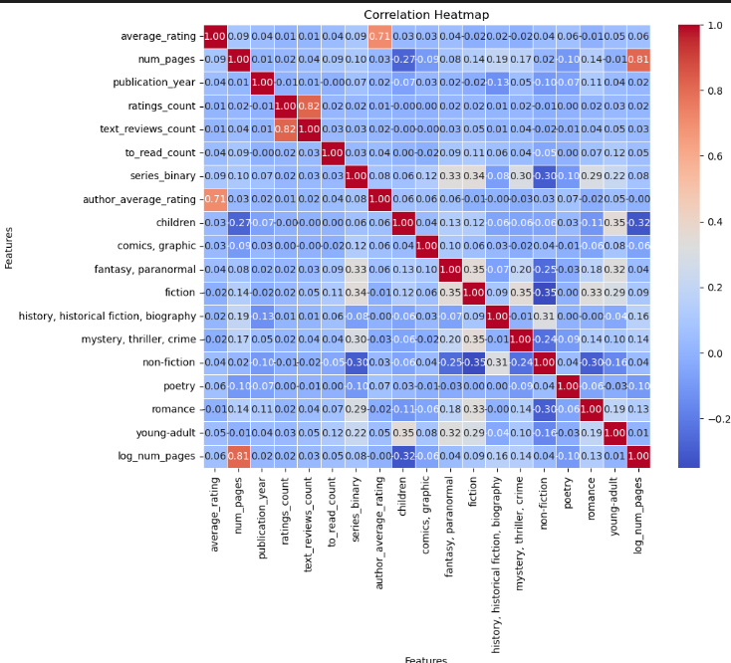
EDA:
Sample 3 Data

Slide 13
Model Optimization & Selection

Slide 14

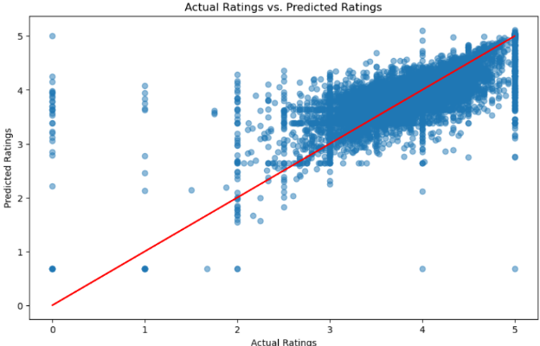
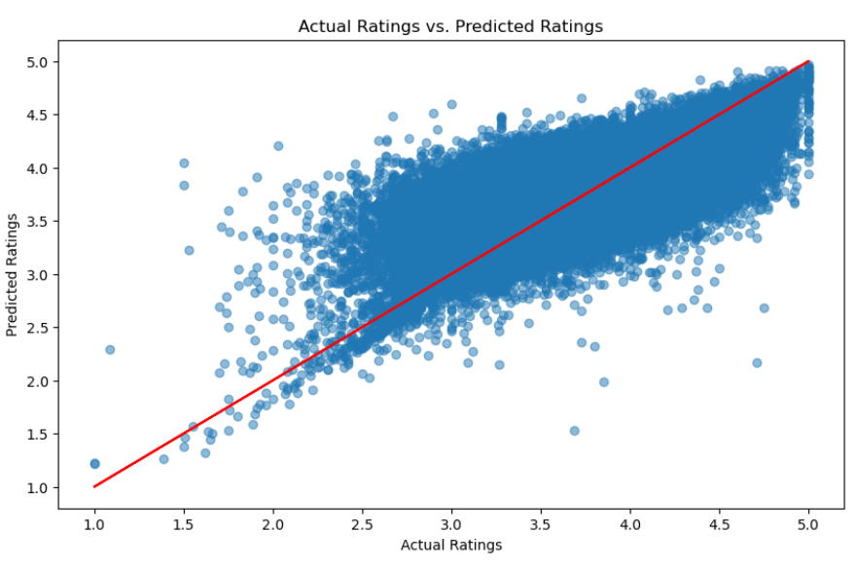
Model 1: Neural Network

Slide 15
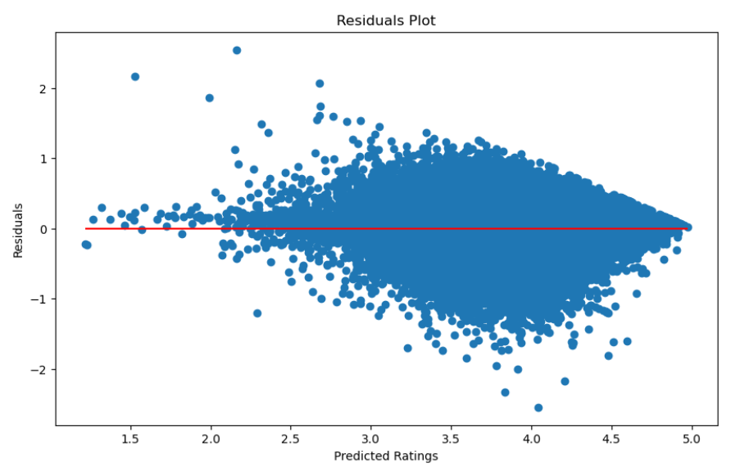
Model 1: Neural Network

Slide 16
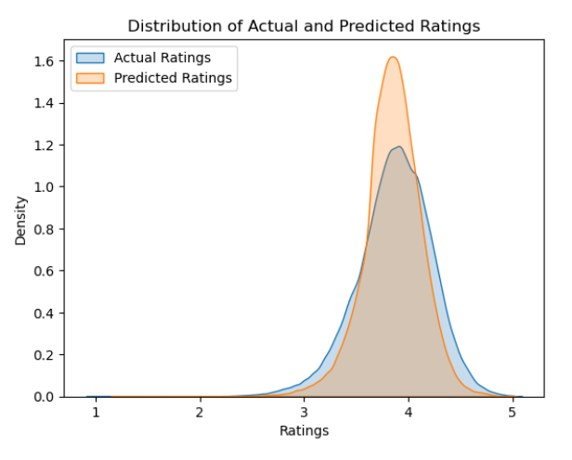
Model 1: Neural Network

Slide 17

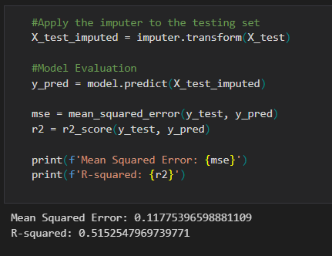
Model 2:
Linear Regression

Slide 18

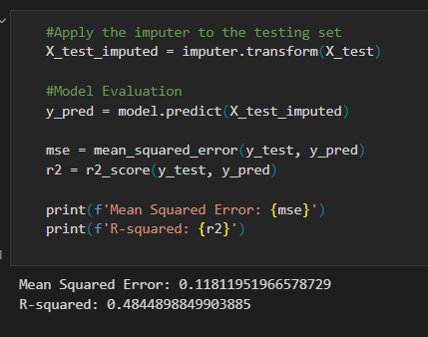
Model 2:
Linear Regression (Again)

Slide 19

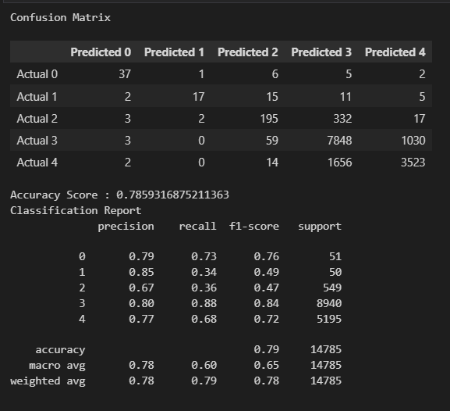
Model 3: Random Forest

Slide 20

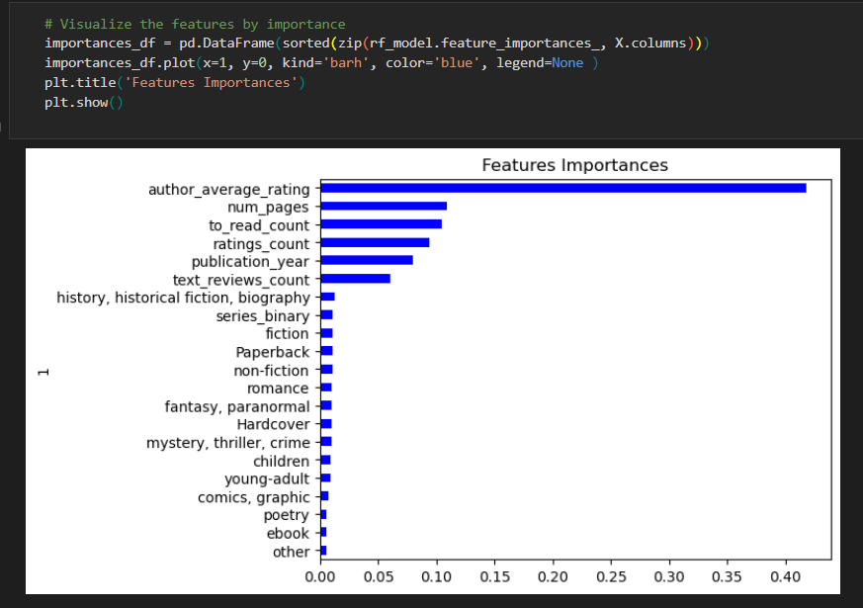
Random Forest Model:
Feature Rankings

Slide 21
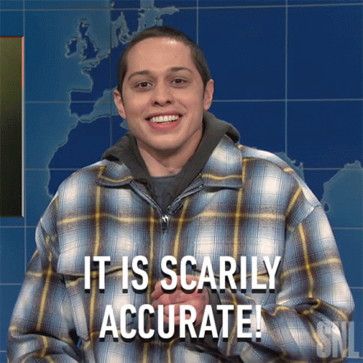
BUT YOU, BRAVE AND ADEPT FROM THIS DAY ON . . . THERE’S HOPE THAT YOU WILL REACH YOUR GOAL . . . THE JOURNEY THAT STIRS YOU NOW IS NOT FAR OFF.
“
”
- HOMER, THE ODYSSEY

Slide 22

CITATIONS
ARTICLES
Mengting Wan, Julian McAuley, “Item Recommendation on Monotonic Behavior Chains”, in RecSys’18 [bibtex}
Mengting Wan, Rishabh Misra, Ndapa Nakashole, Julian McAuley, “Fine-Grained Spoiler Detection from Large-Scale Review Corpora”, in ACL’19 [bibtex]
DATA
Wan, Mengting. (2023).goodreads.GitHub.https://github.com/MengtingWan/goodreads
Ahmad. (2023, October). Goodreads Book Reviews, Version 1. Retrieved November 22, 2023 from https://www.kaggle.com/datasets/pypiahmad/goodreads-book-reviews1

Slide 23




